Slide 1
Properties of HD 189733 b
Brigid Evans-Dix (coding and slides)
Dasha Crocker (coding, slides and calculations)
Maya Legersky (paper)

Slide 2
01
Background & Motivation

Slide 3
Overview
Astronomers want to understand the diversity of exoplanets to constrain theories of planet formation.
Many systems contain short-period gas-giant planets that are not seen in the solar system.
Measuring the properties (and their uncertainties) of these planets helps develop models of planet formation.

Slide 4
02
Methods

Slide 5
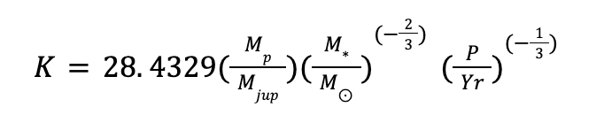
Planet Mass
In order to obtain the mass of the planet, we used the equation:
However, we are missing K and P. We can find P using a lombscargle periodogram, and K through the Markov Chain Monte Carlo.
Once K and P were obtained, rearranging the equation gives us what we need. The mass of the star was taken from the NEA site.

Slide 6
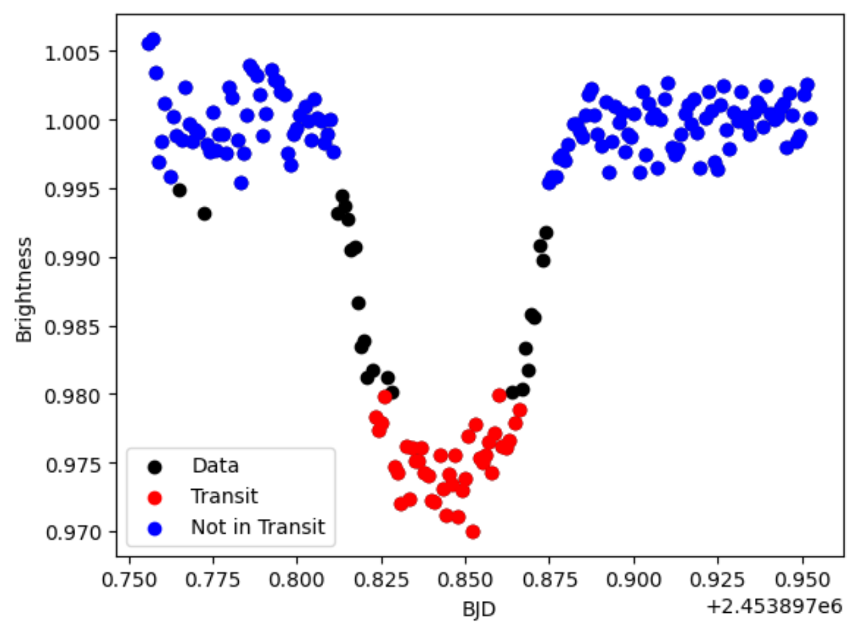
Planet Radius
To find the planet radius, we first examined a graph of the magnitude versus time (BJD). This highlights two “sections” - the out of transit magnitude and the in-transit magnitude.
By restricting the data, we can divide it into in-transit and out of transiy. In our case, we chose our cut-offs to be less than 0.98 or greater than 0.995.

Slide 7
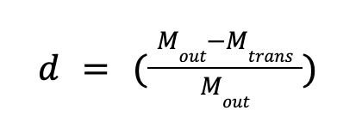
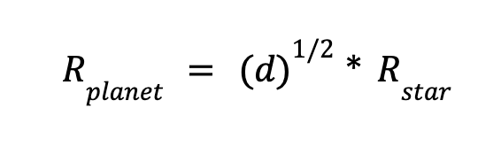
Planet Radius (cont)
Once we have this data divided up, we found a transit depth array using the transit depth equation, and then used these values to find the radius array through the transit depth stellar radius equation.
Finding the mean gives us the radius, and the standard deviation gives us the error.

Slide 8
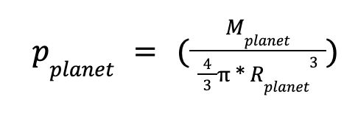
Density
Finding the density is similar to the previous derivations. The equation we used was:

Slide 9
03
Results

Slide 10
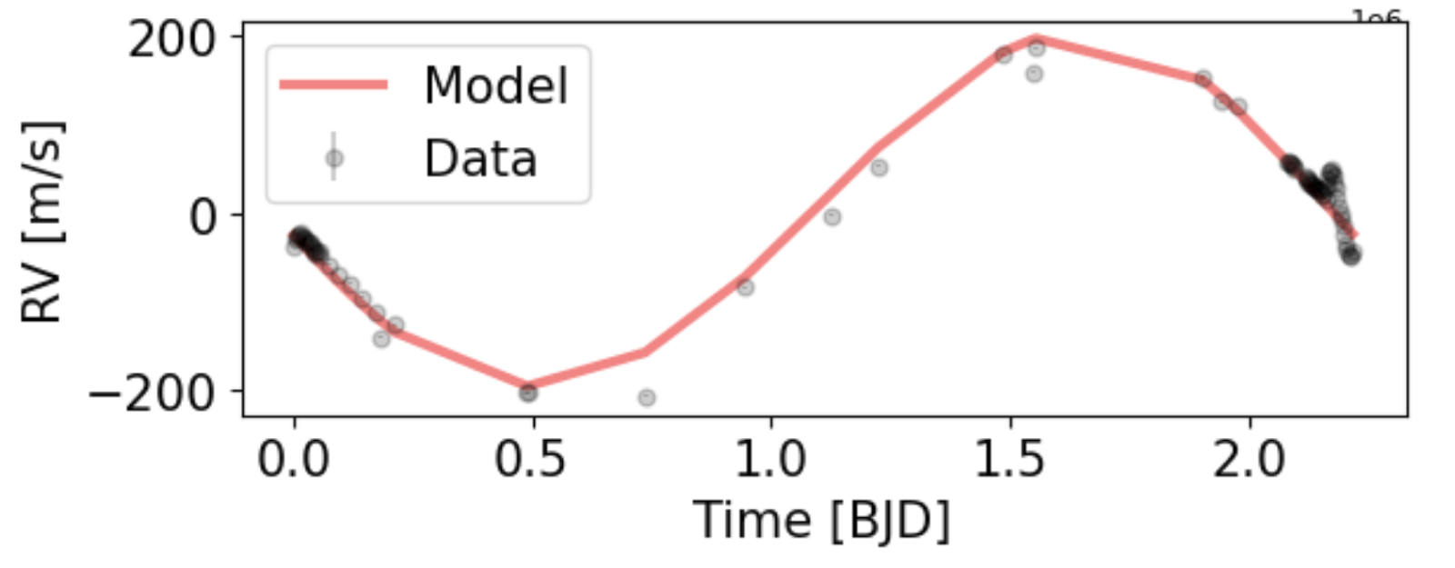
Radial Velocity Model
We show our fitted model with measured radial velocities.
The Model generally fits well, though the fit could likely be improved

Slide 11
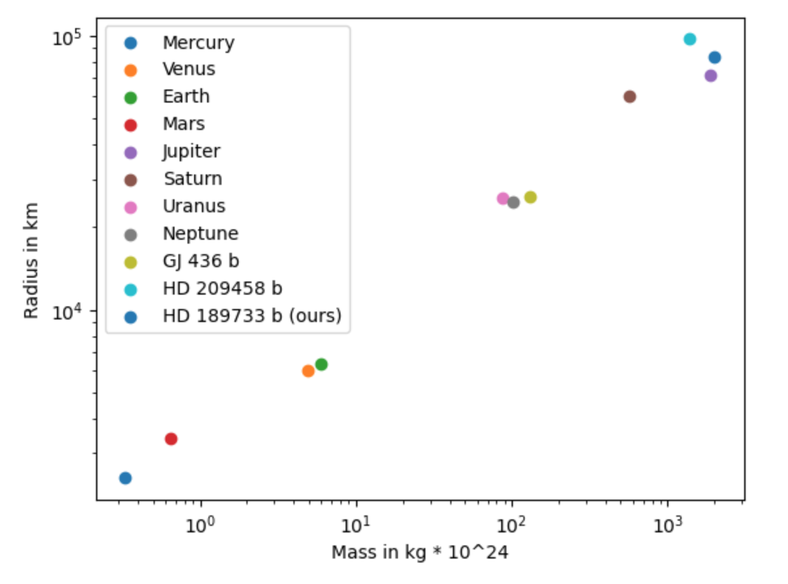
Overall Results
The planet appears to have…
…a mass of 1.148 +/- 0.015 Mjup
…a radius of 1.199 +/- 0.006 Rjup
…a density of 1.009 +/- 0.0199 g/cm^3.
This is reasonable compared to other exoplanets of similar mass and radii.

Slide 12
04
Conclusion

Slide 13
Conclusion
HD 189733 has a reasonable mass, radius and density compared to other exoplanets.
This planer is likely a jovian planet according to the mass-radius relation.

Slide 14
THANK YOU
COMPANY NAME

